Slide 1


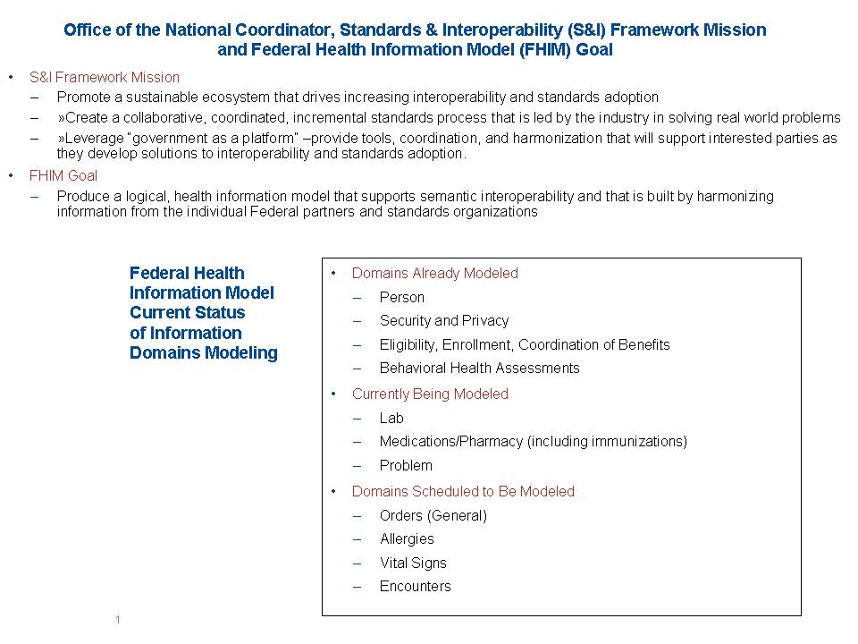
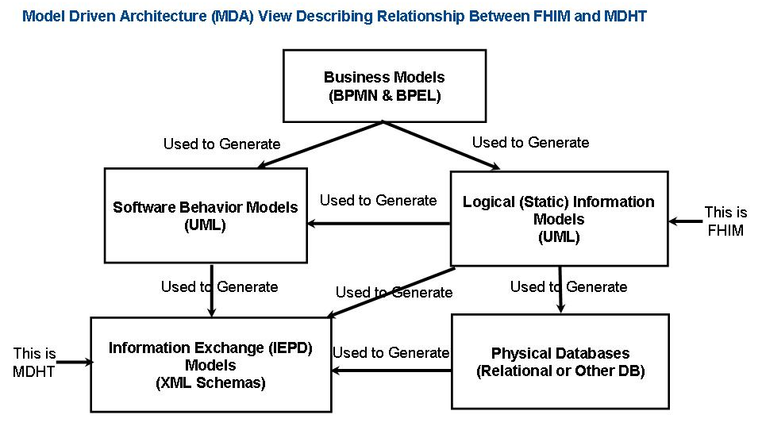
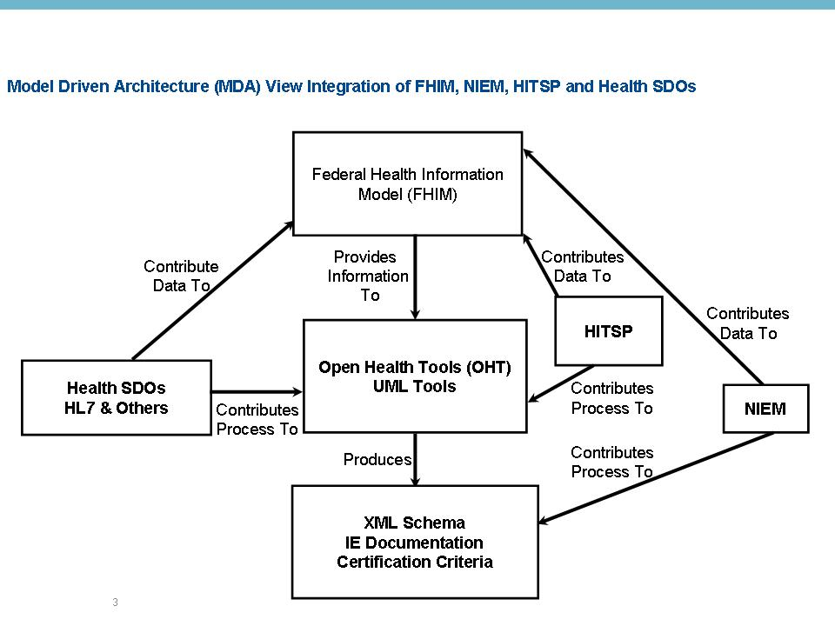
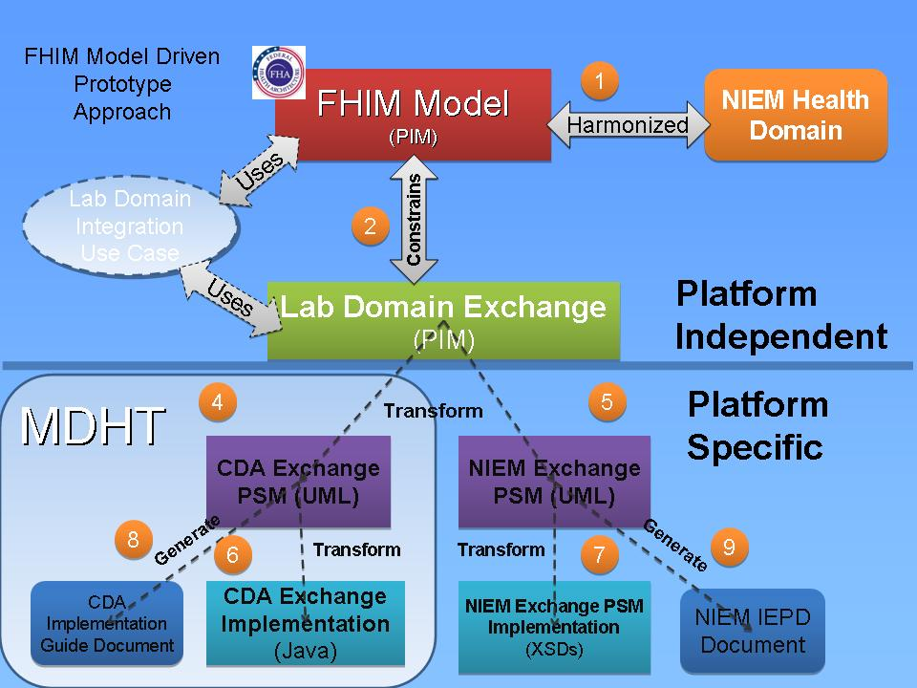
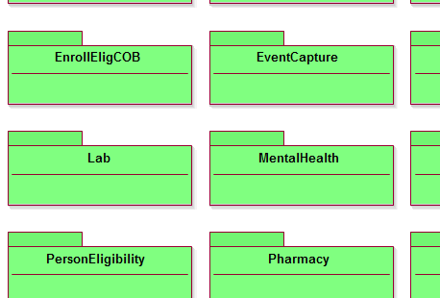
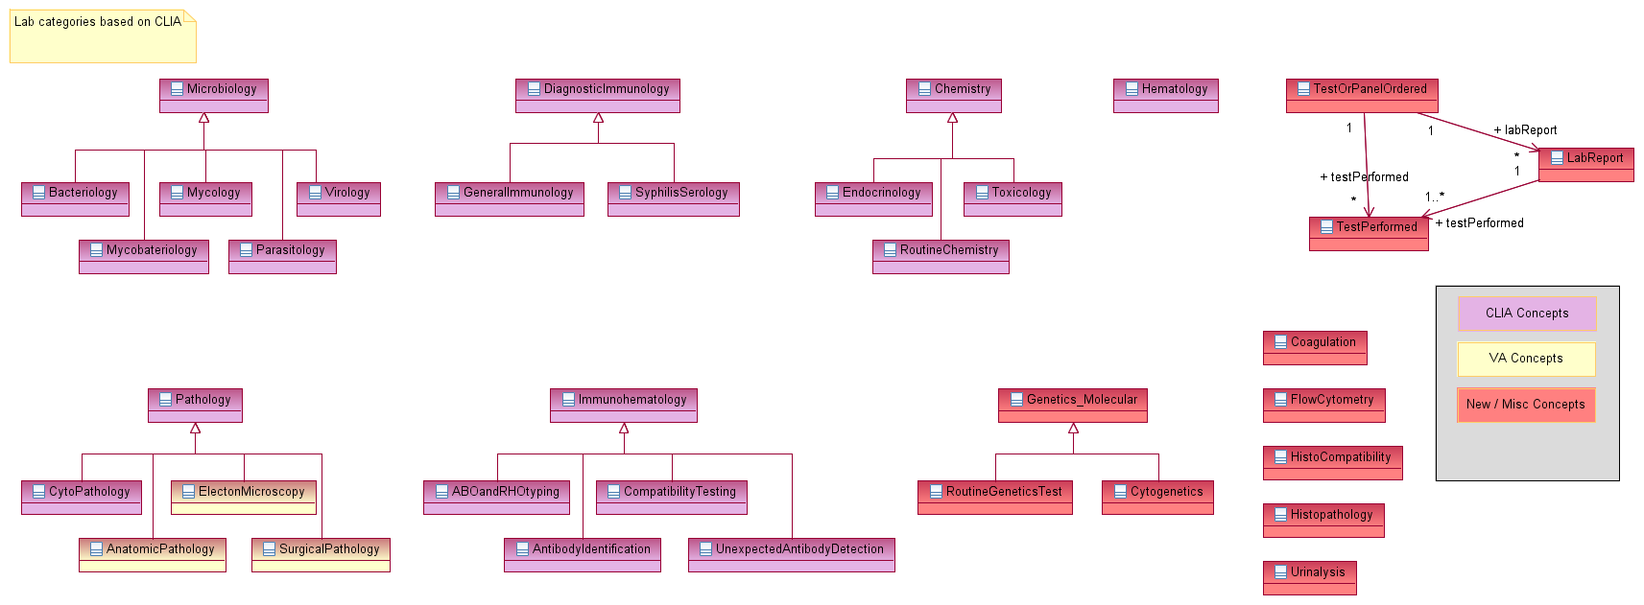
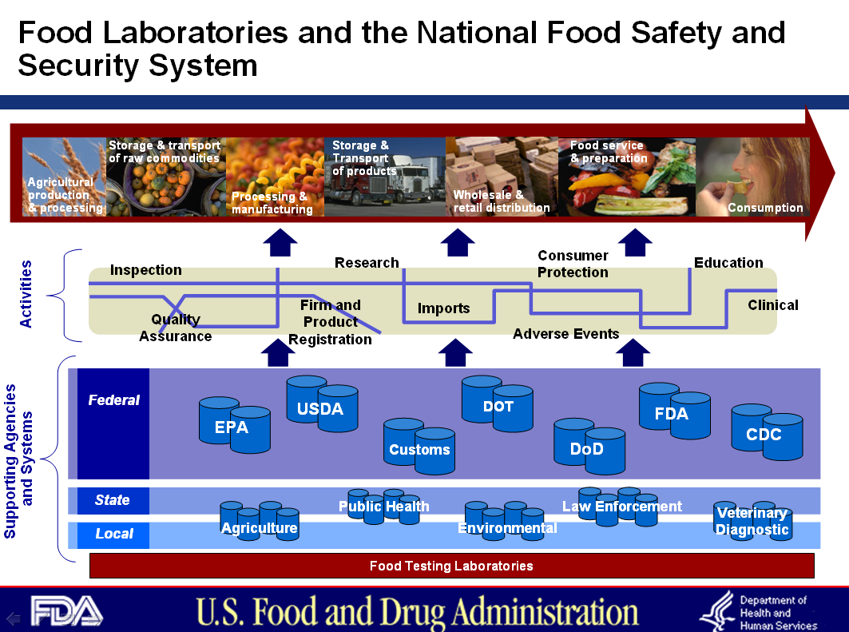
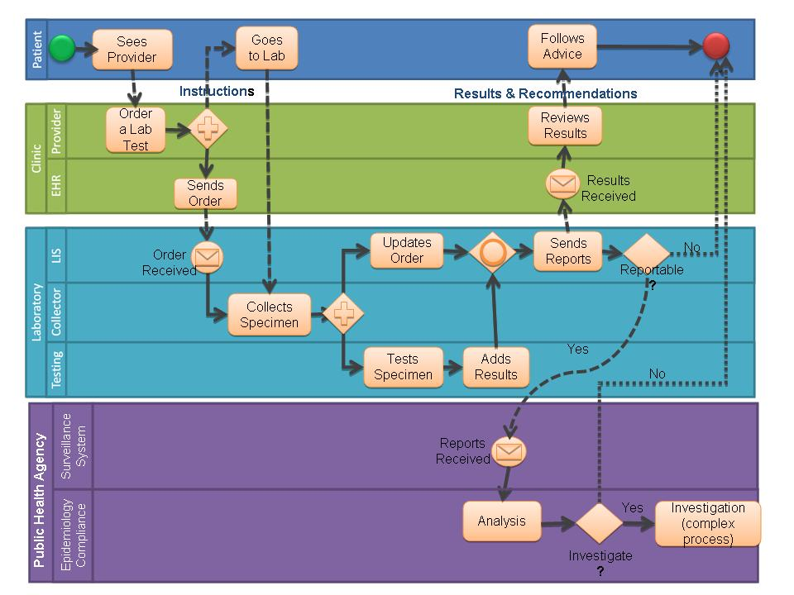
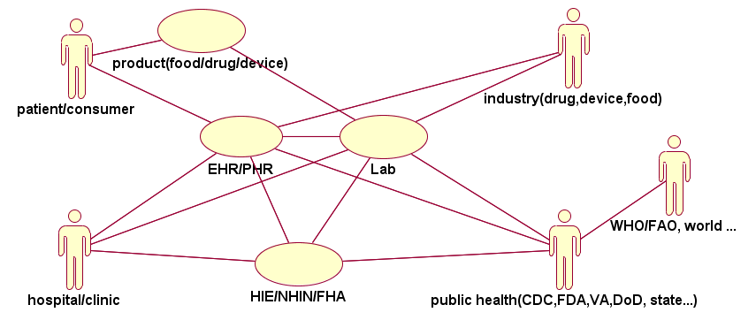
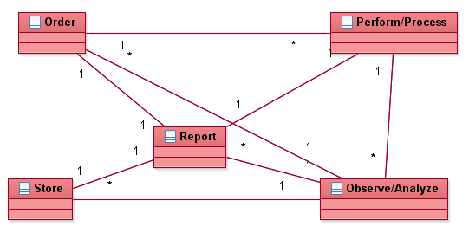
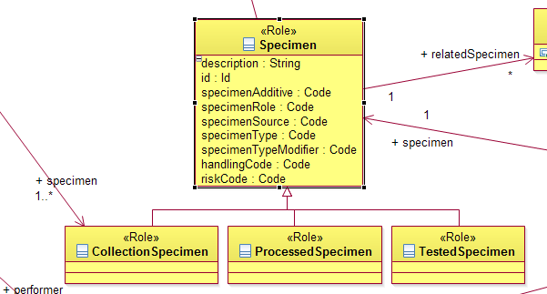
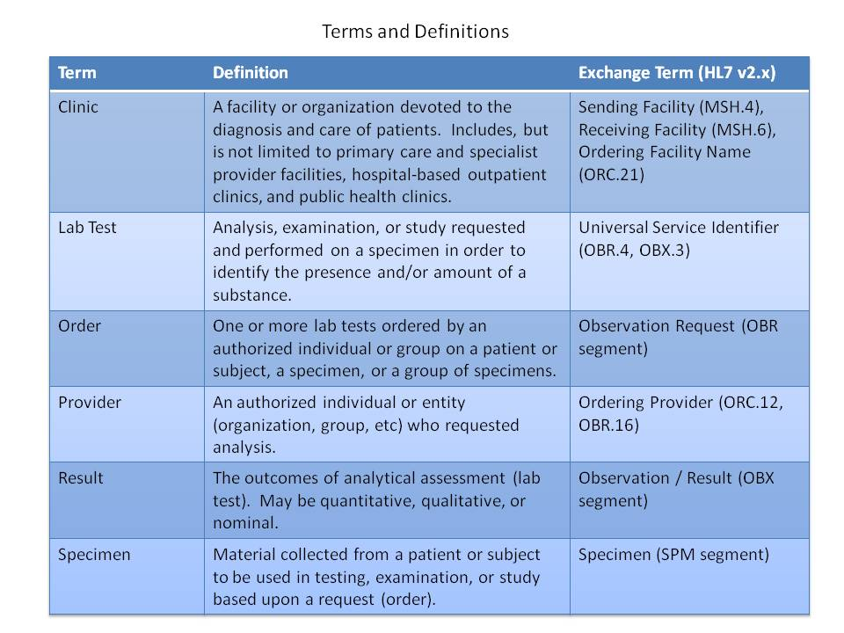
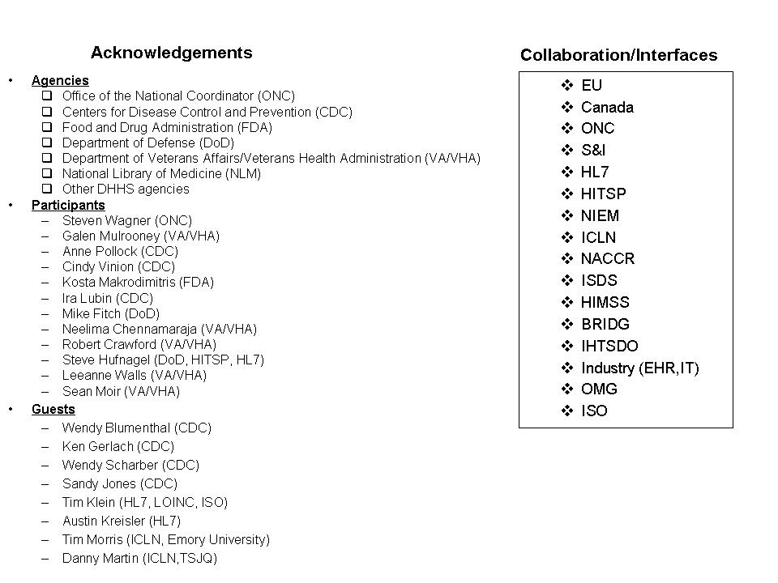
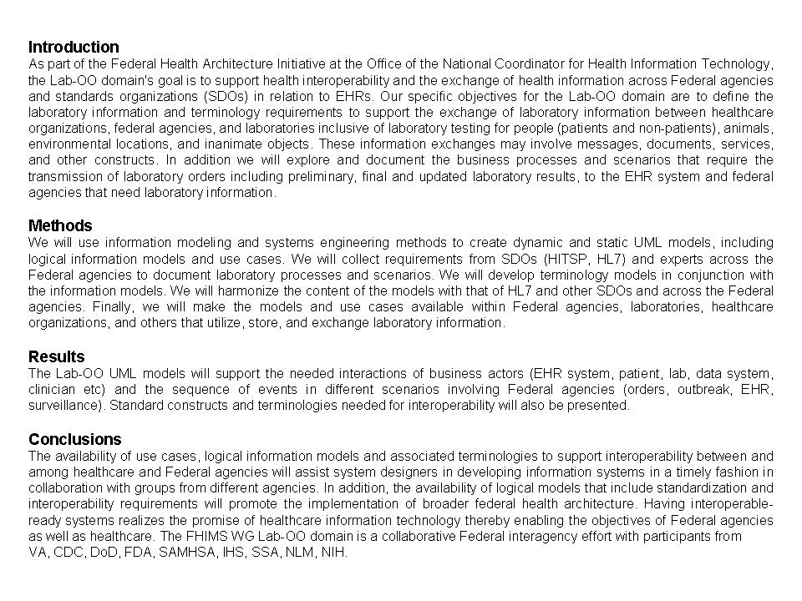
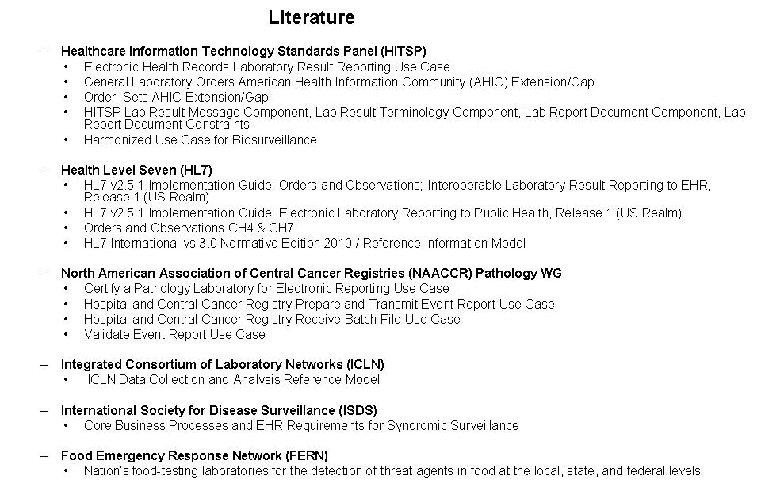
Federal Health Information Modeling & Standards (FHIMS) Work Group (WG) - Laboratory, Orders & Observations (Lab-OO) :
Information Exchanges and Electronic Health Records (EHR)
Steve Wagner³, Kosta Makrodimitris¹, Neelima Chennamaraja², Galen Mulrooney², Cynthia Vinion^{4 ;}
(1)Food and Drug Administration; (2)Consultant to Veteran's Health Administration; (3) Consultant to Office of National Coordinator, Federal Health Architecture; and 4) Northrop Grumman Consultant to Centers for Disease Control and Prevention
Information Modeling Concepts
Business cases and actors for Lab-EHR: patient-consumer and products

